Slide 1

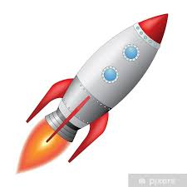
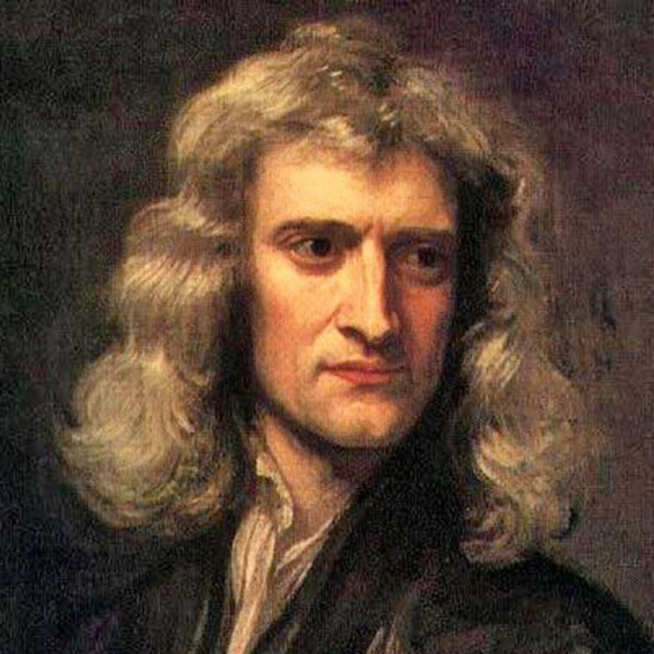
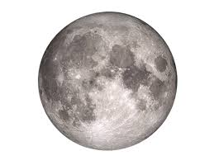
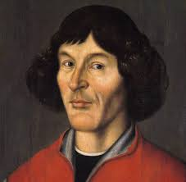
解密神奇的宇宙 Unlocking the secrets of the Universe
Session 2.2: from Einstein to Hawking
Solving the mystery of gravity
Today’s VIP guest list
As we learned in session 1, Newton managed to unify the idea of Earth’s pull on our feet with that of planet movement and indeed interaction between any two bodies with mass – the universal law of gravity was proposed.
But what Newton’s theory did not explain is: what is gravity, where does it come from, and how do we understand it?
In the beginning of 20th century, gravity was understood as a “mysterious force acting at a distance” – scientists had no idea where it comes from. Even worse, certain astronomical observations could not be explained using Newton’s laws. This is when Einstein had his second breakthrough, concerning this time non-inertial reference frames: accelerating systems.
Isaac Newton
Session objectives
Appreciate the equivalence between acceleration and
Key terms
Special Relativity
狭义相对论
time dilation
时间变慢
speed of light
光速
inertial frame of reference
不变惯性参考坐标系
Length contraction
长度变短
Relativistic mass
相对论性质量

Slide 2

解密神奇的宇宙 Unlocking the Secrets of the Universe
Light speed
光速
Speed that light travels through vacuum with (= 300,000,000 m/s)
Heliocentrism
The model of the Solar System where the Sun is in the middle, and planets are orbiting around it.
Ockham's razor
奥卡姆剃刀
The “rule of thumb” that tells us that if we have 2 answers to the same problem, we should pick the simpler one.
Sometimes Ockham's razor is formulated as: “the simplest solution is the best one”
Scientific revolution
科学革命
A time when due to e.g. new evidence, new experiments, new proofs etc. a major paradigm in science is proven to be wrong. For example, Aristotelean mechanics was overturned （颠覆）by Newton’s mechanics.
Interstellar travel
If we imagine that humans have found a planet that is habitable to us “only” 4 light years away, how long does it take light to get there?
When we observe this planet via a telescope, and we observe an alien waving their hand at us, “when” did they wave their hand?
1
Relative speeds
If we are sitting on train and watching the view from the window, if might seem to use sometimes that it is not the train moving, but actually the world outside the window is moving.
From Earth’s surface, it looks like the Sun is rotating around Earth. But if we travel to the Sun and look around, we will actually think that it is the planets that are moving.
So, what is moving, and does it make a difference?
Copernicus vs. Church
In middle ages, it was common to assume that the Earth is in the center of the Solar system (or even: in the center of the universe). The Catholic Church supported this idea, as it made Earth in some way “special”, as “God’s creation”.
However, scientists found it extremely difficult to describe the motion of objects around Earth in this system.
All this changed when Nicolaus Copernicus proposed a new model, where the Sun was “fixed” in the middle if the Solar system, with planets orbiting around it.
This model was much simpler than the original model.
Which model is “correct” and why?
Important term: Ockham’s Razor （奥卡姆剃刀）
The notion (or “rule of thumb”) that dictates we always pick the simplest solution to the given problem.
JinJin STEM Academy

Slide 3

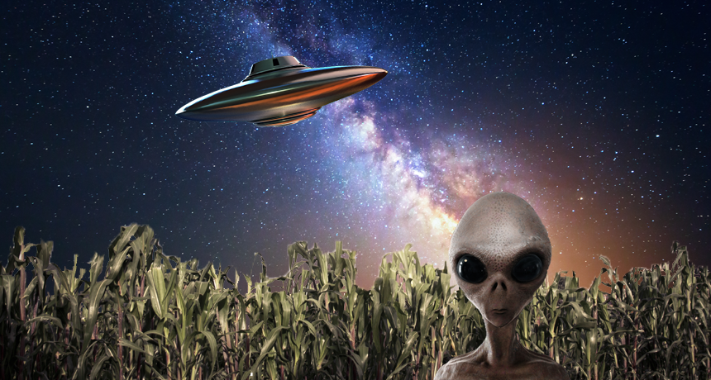
解密神奇的宇宙 Unlocking the Secrets of the Universe
Frame of reference
坐标系
A system in which we describe things (e.g. position and movement of bodies)
Inertial frame of reference
不变惯性坐标系
A frame of reference that is not accelerating
Newton’s 1nd Law
If there is no forces acting, everything is in rest, or moving with constant speed with respect to you.
Hello world, we are just passing by!
Imagine we are traveling through space in our spaceship that can travel very fast, approximately 50% of the speed of light.
We are passing by a new planet, and as we do, the aliens living there are watching us carefully and taking measurements to test their new theory concerning light, speed, relativity and the universe.
From the aliens’ point of view, what is your speed?
If your spaceship has a front light attached to its cockpit, and you turn it on (to be able to spot asteroids and space dust in your way as you steer through space), from the aliens’ perspective, what is the speed of the light you are using? What is this speed from your perspective?
You launch another, smaller unmanned ship traveling in the same direction, to check the route ahead of you. You launch it with the speed of 70% of the speed of light. From your perspective, how fast is this vehicle traveling with? From aliens’ perspective, how fast is it moving?
1
JinJin STEM Academy

Slide 4

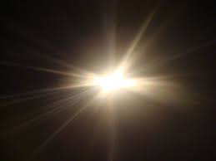
解密神奇的宇宙 Unlocking the Secrets of the Universe
Einstein chasing light
By the end of 19th century, scientists have already managed to describe light as an oscillating wave.
Different wave lengths (different oscillation frequencies) correspond to different “types” of light. For example, different colors are just light of different frequencies. Microwaves used in microwave ovens are also different “colors” of the same light.
In late 19th c., 16-year old Albert Einstein asked himself: what if I travel with the speed of light, next to a light wave: according to relativity of motion, I should see light “frozen” in place (so really, it will just be a frozen wave not oscillating anymore)
To Einstein, this seemed counterintuitive.
Do you also think it’s counterintuitive to imagine a “frozen” wave?
What is “intuition”?
1
The key postulates of Special Relativity
Laws of Physics are the same in all inertial reference frames.
Speed of light is CONSTANT regardless of what reference frame you are observing it from.
Re-considering spaceship measurements
If we assume that the speed of light is constant in ALL reference frames, what does this mean for our calculations for speed of light in different reference frames, as seen from our spaceship and as seen from the alien planet?
JinJin STEM Academy

Slide 5
解密神奇的宇宙 Unlocking the Secrets of the Universe
Re-considering spaceship measurements
If we assume that the speed of light is constant in ALL reference frames, what does this mean for our calculations for speed of light in different reference frames, as seen from our spaceship and as seen from the alien planet?
JinJin STEM Academy

Slide 6
解密神奇的宇宙 Unlocking the Secrets of the Universe
Time dilation
时间变慢
When we travel with high speed, from our perspective time flows slower than from the perspective of an outside observer fixed with respect to us.
Length contraction
长度变短
When we travel with high speed, from our perspective our length in the direction of motion is longer than from the perspective of an outside observer.
Relativistic mass
相对论质量
The mass objects moving with high speeds have, as consequence of relativity theory. The mass will increase for high speeds.
Speed of light: the universal constant of the universe
The consequence of the second postulate of the Special Relativity theory is that speed of light enjoys a “special status” in the universe
Space and time adjust to make sure that the speed of light remains unchanged.
Time dilation
Imagine we are looking in the mirror aboard our spaceship.
What is the distance that the light travels from our perspective, from our face to the mirror and back?
What is the distance that the light travels from aliens’ perspective, from our face to the mirror and back?
What is the time it takes light to travel this distance from both frames of reference?
If we assume speed of light cannot change, what does this mean for your two reference frames? What should the time equal, as observed by yourself, and as observed by the aliens?
***Now, what will be the length of your spaceship, as observed by you, and as observed by aliens?
JinJin STEM Academy

Slide 7

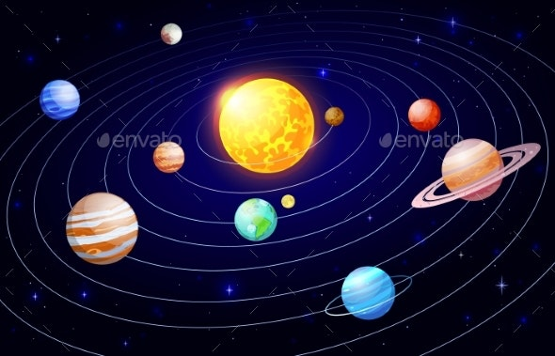
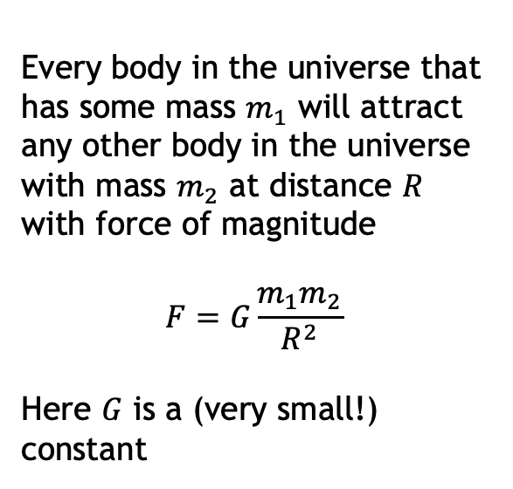
解密神奇的宇宙 Unlocking the Secrets of the Universe
Unification theory
统一理论
A theory that a the same time explains several physical phenomena. It “unifies” （统一）several things that previously were believed to be separate into one framework.
An example of this is gravity: all bodies with mass (including planets, the Moon, stars, black holes, but also you, me and even your cat!) attract each other according to the same math formula.
Conservation laws
守恒律
The ”laws” (general rules) that apply to certain physical quantities.
The most basic conservation laws that you may have already met before are Energy Conservation and Momentum Conservation.
Important term: unification theory
Theories of all sciences – unite!!
A theory that explains several different phenomena using a single framework (框架) is called a “unification theory”
We will learn about several unification theories in this course. The first one is Universal Law of Gravity. Newton’s amazing intuition was that the same force attracts the apple towards Earth’s surface (and causes his headache!) that explains movement of all celestial bodies in the Universe.
Every body in the universe that has some mass $m_{1}$ will attract any other body in the universe with mass $m_{2}$ at distance $R$ with force of magnitude
$$F=G\frac{m_{1}m_{2}}{R^{2}}$$
Here $G$ is a (very small!) constant
Food for thought
Scientists like unification theories.
Gravity is one example. Can you think of other examples from physics, biology, chemistry etc.?
Why do scientists “like to unify things”?
JinJin STEM Academy

Slide 8
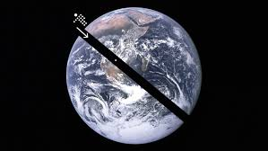
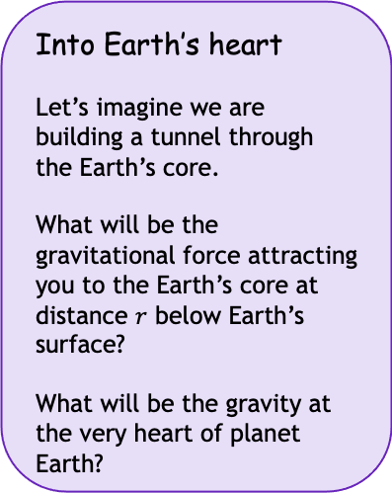

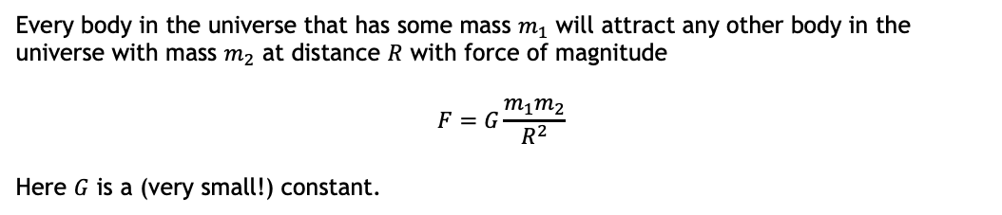
解密神奇的宇宙 Unlocking the Secrets of the Universe
2
Recap on gravity
Every body in the universe that has some mass $m_{1}$ will attract any other body in the universe with mass $m_{2}$ at distance $R$ with force of magnitude
$$F=G\frac{m_{1}m_{2}}{R^{2}}$$
Here $G$ is a (very small!) constant.
Food for thought
What is $R$? How is it measured?
What happens when $R=0$? Is there a paradox here?
Into Earth’s heart
Let’s imagine we are building a tunnel through the Earth’s core.
What will be the gravitational force attracting you to the Earth’s core at distance $r$ below Earth’s surface?
What will be the gravity at the very heart of planet Earth?
Food for thought
Does gravity force every =0?
Are you being attracted by stars in distant galaxies?
Are you attracting the Earth as well?
JinJin STEM Academy

Slide 9
解密神奇的宇宙 Unlocking the Secrets of the Universe
Conservation laws
守恒律
The ”laws” (general rules) that apply to certain physical quantities.
The most basic conservation laws that you may have already met before are Energy Conservation and Momentum Conservation.
Nothing is ever lost in the universe
Conservation laws tell us about certain things that are never “lost” in the universe.
ENERGY 能量
Energy can change its “form” but it never just disappears
Driving a car, we burn fuel to push the car forward: chemical energy is turned into heat and dispersed in the atmosphere, but not “lost”.
Food for thought
We sometimes say that “energy is lost” in certain physical problems. You may have seen this in some physics questions at school before.
What do you think does this mean?
If energy is always conserved, why do we use this term?
MOMENTUM 动量 (mass x velocity)
Momentum in the whole universe also remains conserved
Be careful: when we say “conserved”, we usually assume that we are in a closed, isolated system. If we consider the whole universe as such system, we can say that momentum (or energy) of everything is indeed “conserved” forever.
Application: Escaping planet Earth
Can you use the conservation principle to estimate the speed you need your spaceship to develop to escape Earth’s gravitational field?
JinJin STEM Academy

Slide 10
解密神奇的宇宙 Unlocking the Secrets of the Universe
3
Building rockets!
Rockets burn fuel and eject it with high speed to accelerate. Let’s figure out how this works mathematically, so we can build a rocket and travel to the Moon (and hopefully back!)
Session Summary
Science usually assumes certain things about reality: we call these things “paradigms”. Sometimes, an important paradigm is overturned, which leads to a scientific revolution
Newton’s universal gravity is an example of “unification theory”: a theory that explains many different phenomena as part of a single framework
Conservation laws, such as law of energy conservation and law of momentum conservation, can be used to derive useful results, such as escape velocity and the rocket equation.
We can use these to build rockets that take humans to space, the Moon, Mars, and in the future perhaps also other stellar systems.
Ponder before next class
If classical mechanics does not work for “very small” objects such as atoms or particles, does it mean that it is wrong or in some way incomplete?
Provide 3 examples of a scientific revolution.
When an important paradigm is overturned, the scientific community is often very reluctant to admit this fact. Why do you think this is?
Is it always true that a simple solution is the best solution?
Imagine that there is scientific evidence showing that cats don’t exhibit gravity at all – they just don’t attract anything. What would you think this implies? Would this lead to overturning Newton’s universal theory of gravity?
JinJin STEM Academy

